Slide 1


The Evolving Politics of Corporate Governance
Klaus Ilmonen, LL.D., LL.M. | 2025

Slide 2
Contents
Research Approach
Recent Corporate Phenomena
Political Context of Corporate Law
Evolving Dynamics of Corporate Governance
Legal Implications: Redefining the Corporation?

Slide 3
Research Approach: Law, Economics and Politics
Comparative Corporate Governance
Combining Legal, economic and political approaches
Ruth Aquilera & Gregory Jackson, Comparative and International Corporate Governance (4 The Ac. Of M:ment Annals 485, 513 (2010))
Adding a political/institutional dimension to the shareholder – stakeholder and corporate purpose debates
Goals:
Adding context to corporate phenomena (including ESG)
Understanding legal implications of the politicization of the corporate environment
(Re)defining the corporation for legal purposes

Slide 4
The Politics of Corporate Governance:
Shareholders vs. Stakeholders
Shareholder primacy ensures efficient outcome
Contractual arrangements protect stakeholders
Laws set level playing field (Friedman)
But:
In reality externalities not covered (see Tirole 2001 on CG)
Contracts incomplete
Political system imperfect (costs)
Corporate performance is based on cooperative effort by stakeholders
Key stakeholder groups have legitimate claims on profits
But:
Little normative guidance for how interests are balanced
Decreases accountability (Bebchuk & Tallarita, 2020)

Slide 5
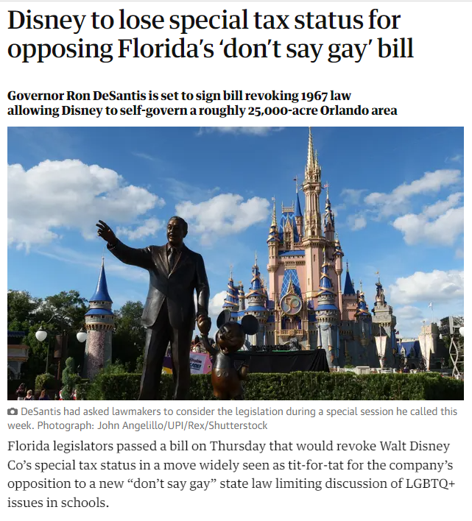
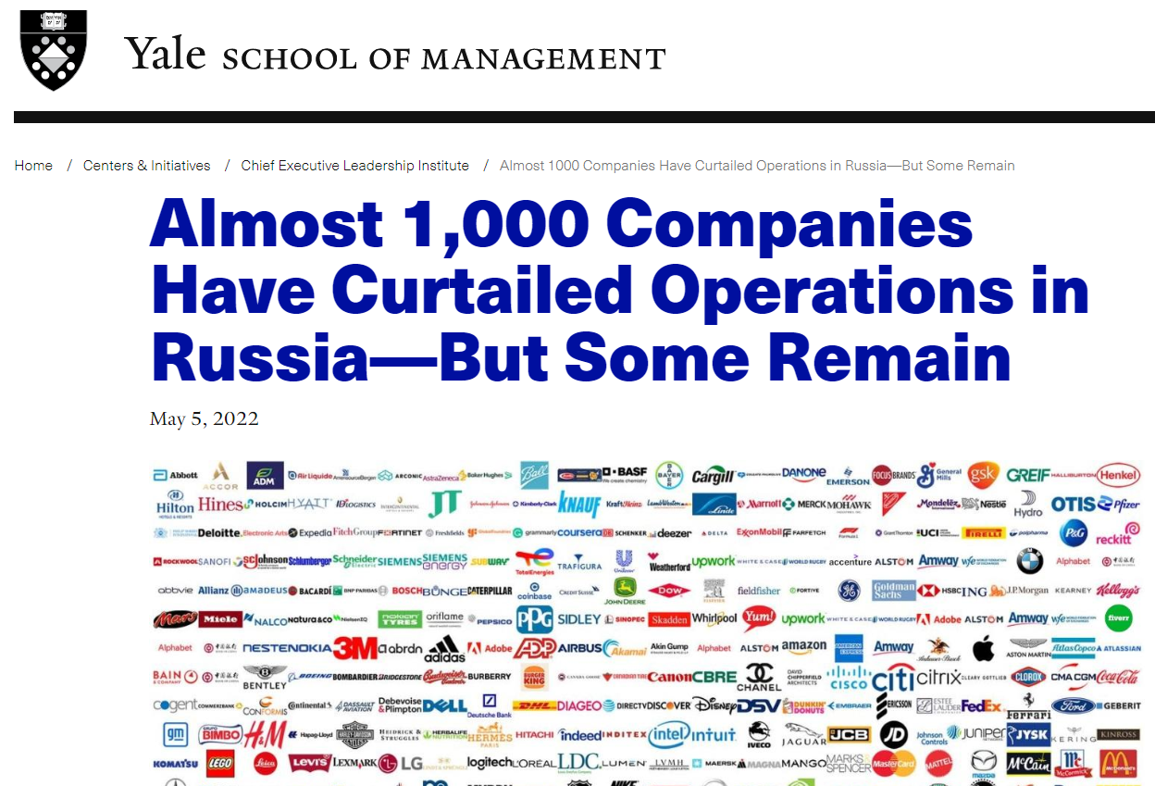

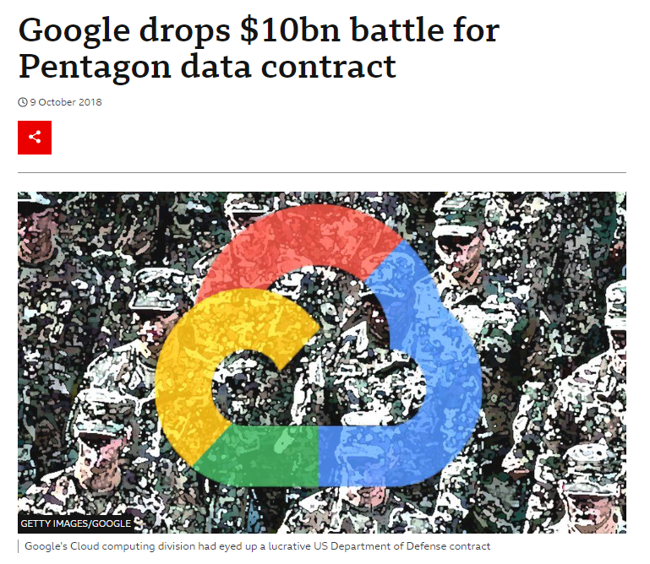
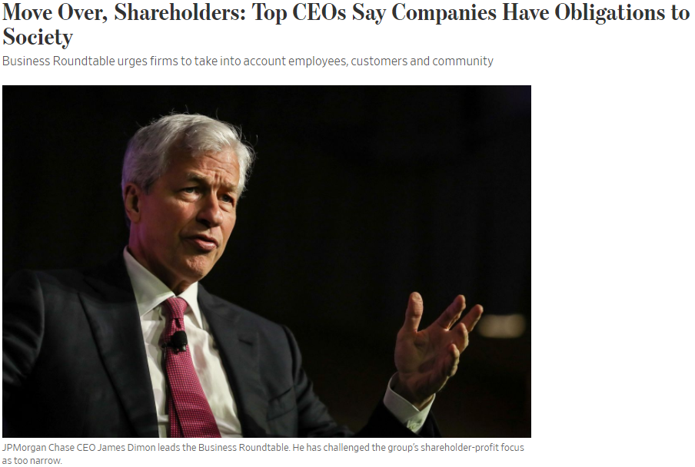
Politicization of the Corporate
Environment
Yale CELI List of Companies - Jeffrey Sonnenfeld and Yale Research Team (uppdateras dagligen)
Mike Ives / The New York Times 1.3.2022

Slide 6

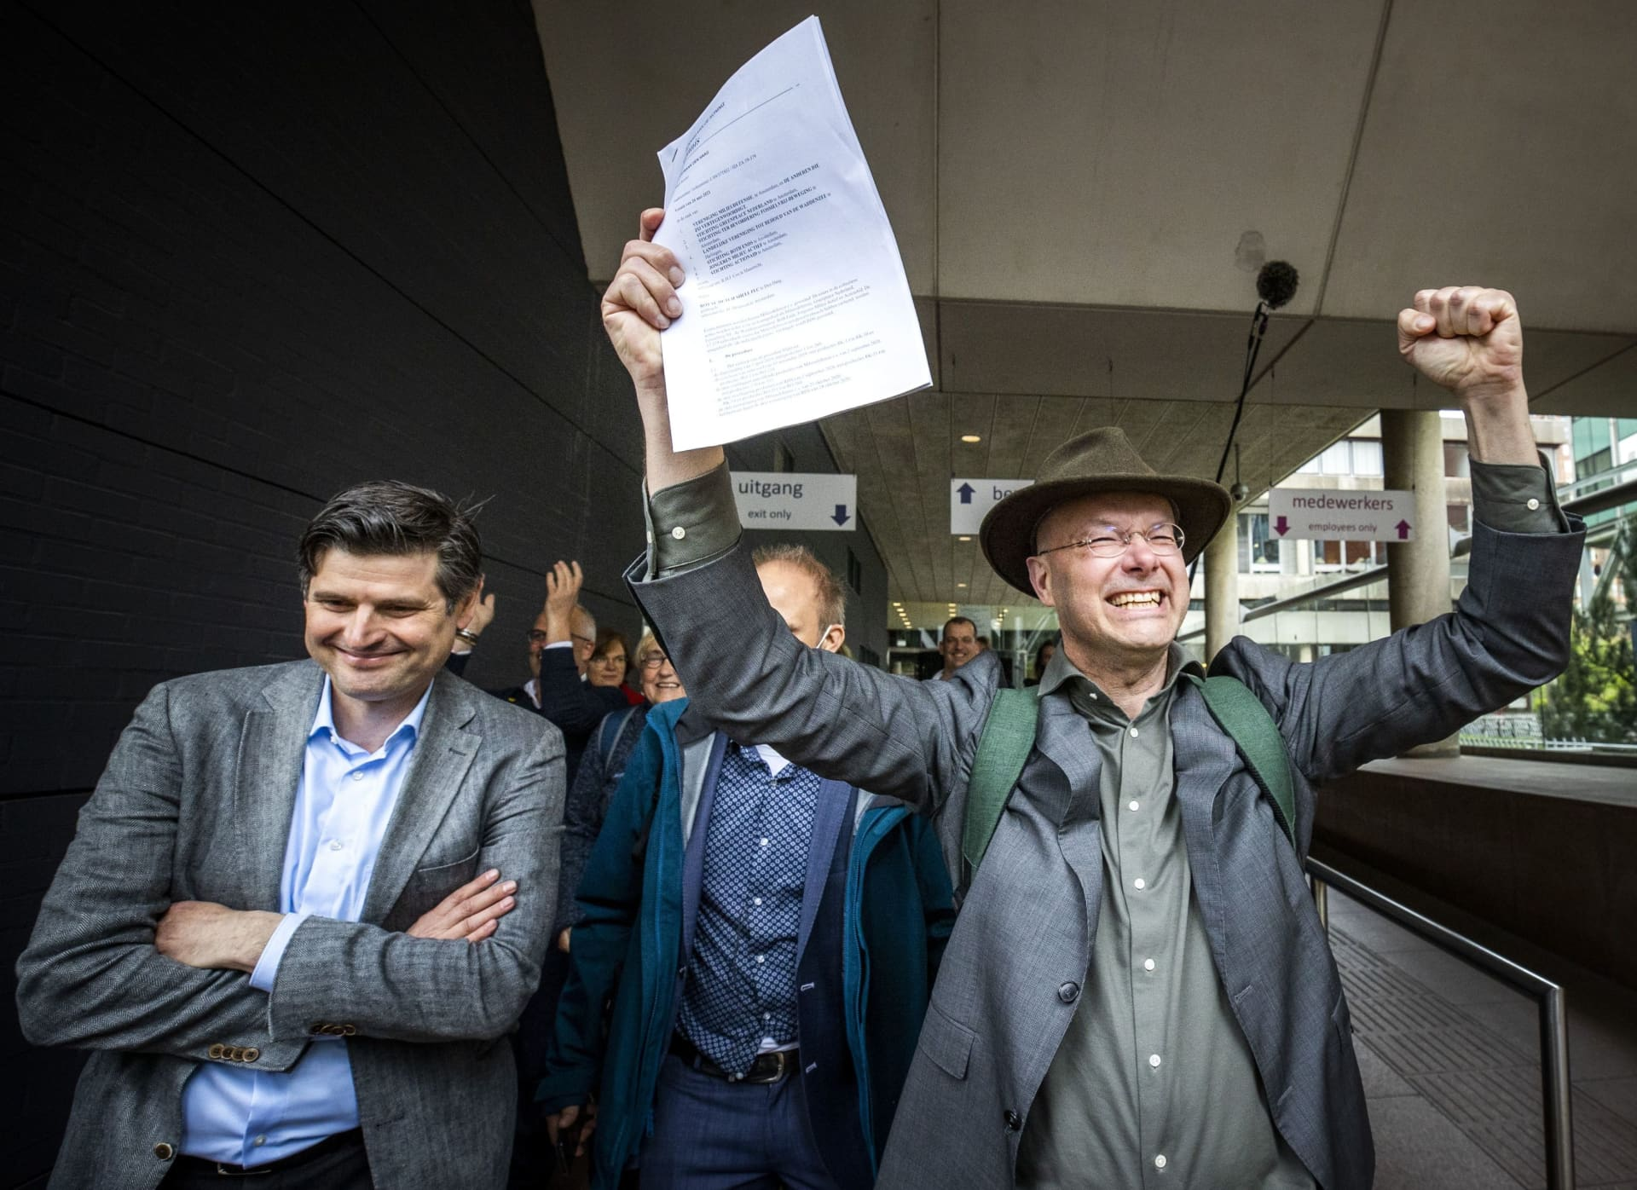
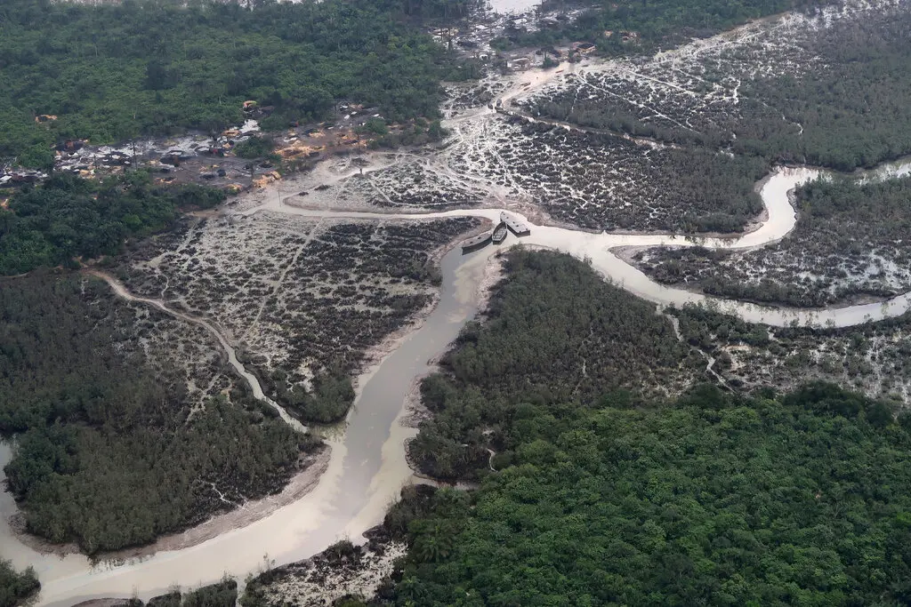
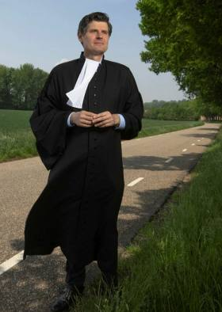
Politicization of the Corporate Environment
U.K. High Court Says Nigerians Can Sue Shell in Britain Over Oil Spills
The Dutch energy company has a presence in Britain, and a judge ruled there was “a real issue to be tried.” (12.2.2021)
“Shell verdict sets scene for more corporate climate cases - Ruling establishing duty of care on human rights grounds suggests more companies will face litigation” (FT, 28/5/2021)
Lawyer who defeated Shell predicts ‘avalanche’ of climate cases (FT, 17.12.2021)
The Niger Delta, where signs of oil spills can be seen in the water in Port Harcourt, Nigeria, in 2018.Credit...Ron Bousso/Reuters

Slide 7
Politicization of the Corporate Environment
Political environment – the ”Regulatory Gap” (Scherer & Palazzo)
  Impact of corporations has increased with globalization
  Impact of national regulators declining?
  Global corporations operate with regulatory gap
  Salience of corporate matters has increased (financial crisis, climate change)
Private politics (D. Baron 2003, Culpepper, 2011)
  Private politics at corporate level ”a reasonable substitute” (Hart & Zingales)
  Can CG stakeholders also have political agendas? (”Maximizing welfare”)
Political Social Agendas (Pargendler, 2016)
  From EU Commission Company Law Action Plan 2012 to EU Corporate Sustainability DD initiative in 2022
  “[C]orporate governance has recently been enlisted as a solution to the greta social issues of our time, such as income inequality, gender imbalance, human rights, and environmental protection” (Pargendler, 2016).

Slide 8
The Politics of Corporate Governance:
A New Corporate Dynamic
Political agendas vs. economic agendas of corporate constituencies
  Long-term shareholders
    Pension institution liabilities (health of population) vs. long-term growth
  Diversified shareholders
    Effect of externalities on portfolio vs. short-term profits
  Communities
    Emissions and pollution concerns vs. employment
  Employees
    Political needs vs. jobs
  Nation states
    Taxes, emission concerns vs. jobs and investments
  Political entrepreneurs
    Mass interest and support (climate change) vs. lobby interests and short-term economic growth

Slide 9
Dynamics of EU Corporate Regulation
Supranational political dynamic
  Coordination costs (Mancur Olson) different from national level (Ferrarini & Miller, Kahan)
  Sunk costs and “harmonization vs. competition” (Sun & Pelkmans, Johnston)
  “Varieties of capitalism”
  Multilevel governance (Helen Callaghan)
EU Institutional Dynamics
  Commission agenda-setting powers / Council and parliamentary dynamic
  The Politics of Policy (Giandomenico Majone, Elinor Ostrom)
  The Regulatory State (Giandomenico Majone)
  EU Power (Anu Bradford)
Using CG for policy
  Political pressure
  EU Commission Policy Programs: CG as an instrument (Pargendler, Ilmonen)

Slide 10
Evolving Dynamics of Corporate Governance and Legal Implications

Slide 11
Political Context – Legal Implications
Political context of corporate governance and corporate law
  Concentrated / dispersed ownership (Mark Roe)
  Political context of limited liability (Paddy Ireland)
  The polity of the EU (Bastiaan van Apeldoorn and Laura Horn)
The political economy context of the modern corporation
  Capital intense industries
  Equity capital scarce
  Level of specialization of employees lower than today
  Scalability low?
  Private corporations less dominant than today

Slide 12
Political Context - Legal Implications:
Characteristics of the Modern Corporation
  Independent legal personality
  Limited liability
  Transferable shares
  Delegated management (board)
  Investor ownership
  (Kraakman et al., The Anatomy of Corporate Law)
Challenges to the Modern Corporation?
  The volatility of the enterprise
    Liquidity of corporate assets has increased
    Rapid technological development - scalability
    Changes in bargaining positions of constituencies
  Piercing the corporate veil
    Competition regulation
    Environmental legal cases
  Development of corporate finance
    Hybrids
    Prefs and commons (Trados)
  Entrepreneurially driven companies
    Ownership and control
    PE minority stakes?
  New Stakeholders?
  Human capital
  Interest groups
  Shareholders are not special?
  Is equity capital a scarce commodity?

Slide 13
Towards New Corporate Governance?
Increasing Reporting Requirements
  Transparency regarding corporate externalities
  Tools for monitoring by “corporate outsiders”
  Intervention through politics and/or governance
Increasing Corporate Accountability
  Corporate litigation
  Lower threshold for liability among group companies
  Limited possibility to ring-fence risk
Obligations towards external constituencies
  Standards and obligations applied through the value chain?
  Interest group interests increasingly reflected in corporate policies
  Stewardship

Slide 14
Towards New Corporate Governance?
New stakeholders introduced to the CG framework
  Availability of new corporate forums and processes for stakeholders (community representatives and activists)?
  “Social license to operate” codified?
  Stakeholder impact will increase
Corporate purpose?
  Independent legal personality of the corporation recognized
  It is possible to pursue multiple policies through the corporate organization
  “Purpose” defined at stakeholder level?
Changes to international corporate taxation
  Likely to ultimately increase corporate influence on national level policies

Slide 15
Legal Implications: (Re)defining the Corporation
Evolving characteristics of the Corporation:
  Corporations defined by uniform economic interest under common control?
    Accountability for value chain standards to increase?
    Expansion of “Konzernrecht” and “piercing the corporate veil”?
  Transparency as an element of corporate law
    Demand for internalizing externalities
  Corporate Stakeholders
    Recognition of a broader scope of corporate constituencies in corporate law
    Increased obligations of corporate organs related to externalities
    Shareholders remain ultimate beneficiaries – but carry more risk
  The Future of the Corporation
    Corporate purpose vs. Stakeholder purpose/goals?
    Analysis and promotion of other corporate forms?

Slide 16
Thank you for your interest
Klaus Ilmonen
Doctor of Laws (U. of Helsinki)
LL.M. (Columbia Law School)
Visiting Researcher (HLS)

